Slide 1

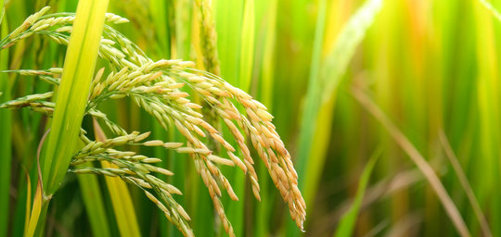
FRESH FROM FARM
Vasantati Chitraksh
Sri Saya Sandeep Karri

Slide 2
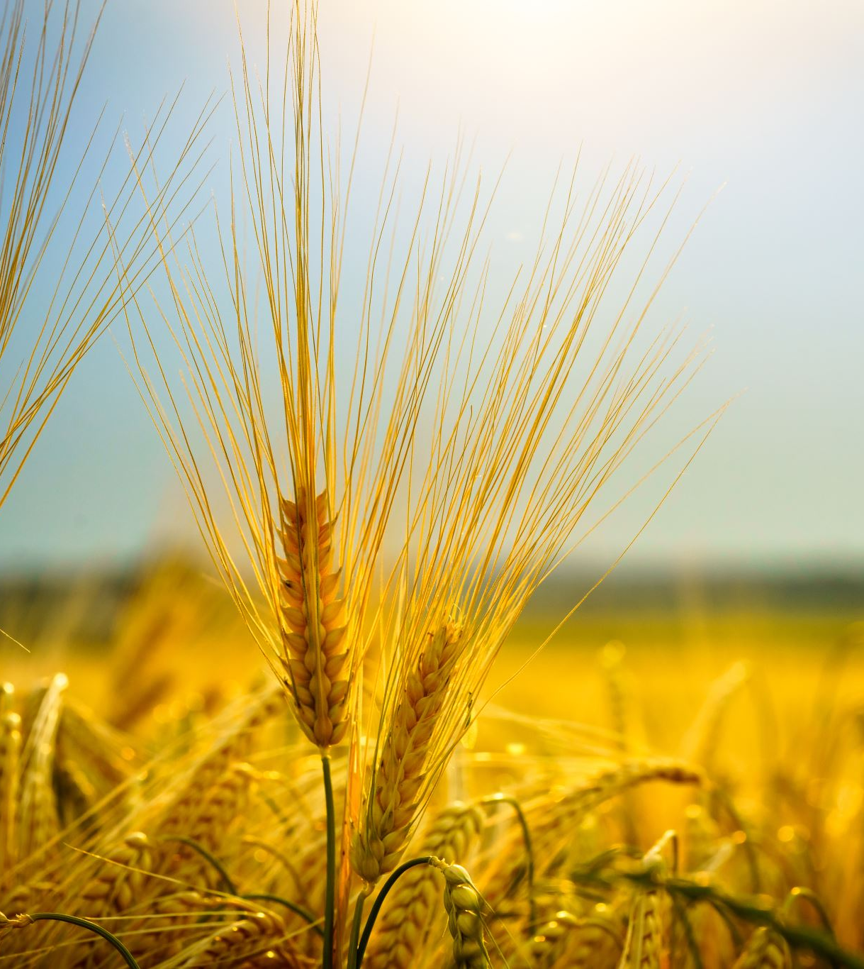
What’s FFF?
Fresh From Farm(FFF) is an application that aims to connect farmers with consumers directly replacing any middlemen.

Slide 3
How FFF functions
The entire program is coded using Java.
The Graphical User Interface is built with Java Swing, a toolkit for Java.
FFF uses an online SQL database which can be accessed from any computer.

Slide 4
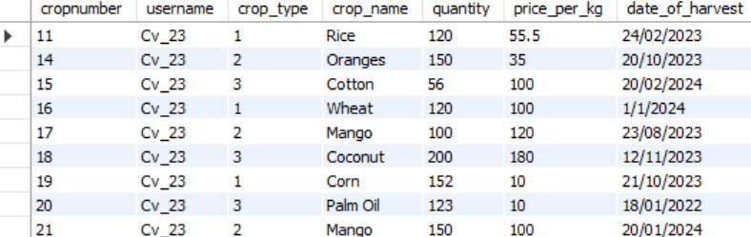
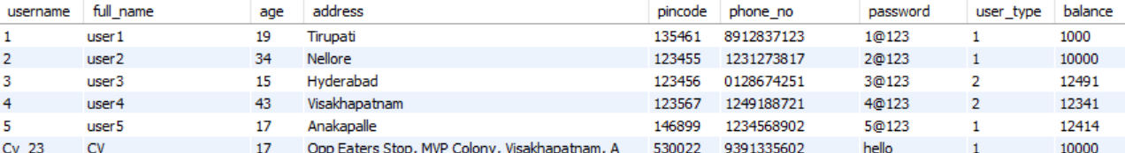
SQL Database:
All data is stored in an online database, which means that the application can be run on any computer.
As of now, two tables are being utilised:
User details, Crops, Orders

Slide 5
Panels Made
As a part of the project, we have made GUI panels. They are:
Login Panel
Sign Up Panel
Farmer Homepage
Profile Panel
Update Crops Panel

Slide 6
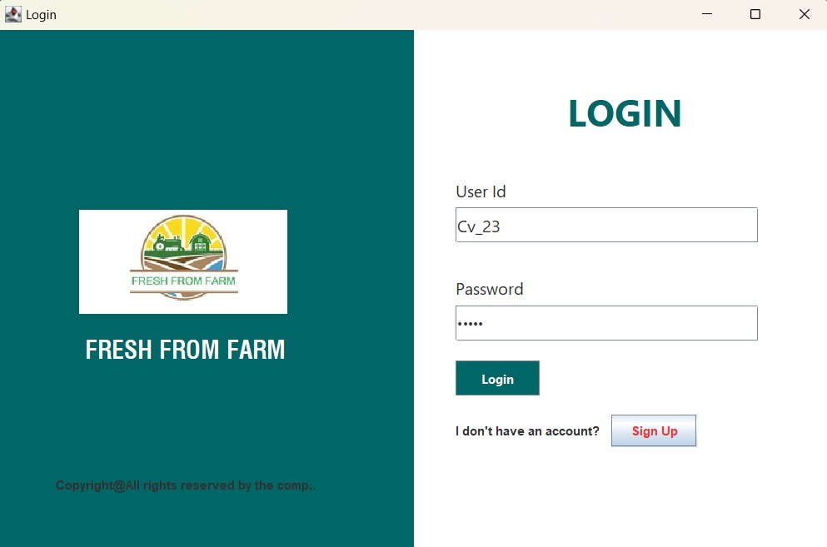
Login Panel
The login panel has two required fields
User ID
Password
Additionally, for new users, there is a sign-up option available.(Will be shown in next slide)
When the user fills the fields and presses Login button, the system automatically detects if the user is a farmer or consumer and displays the appropriate homepage.

Slide 7
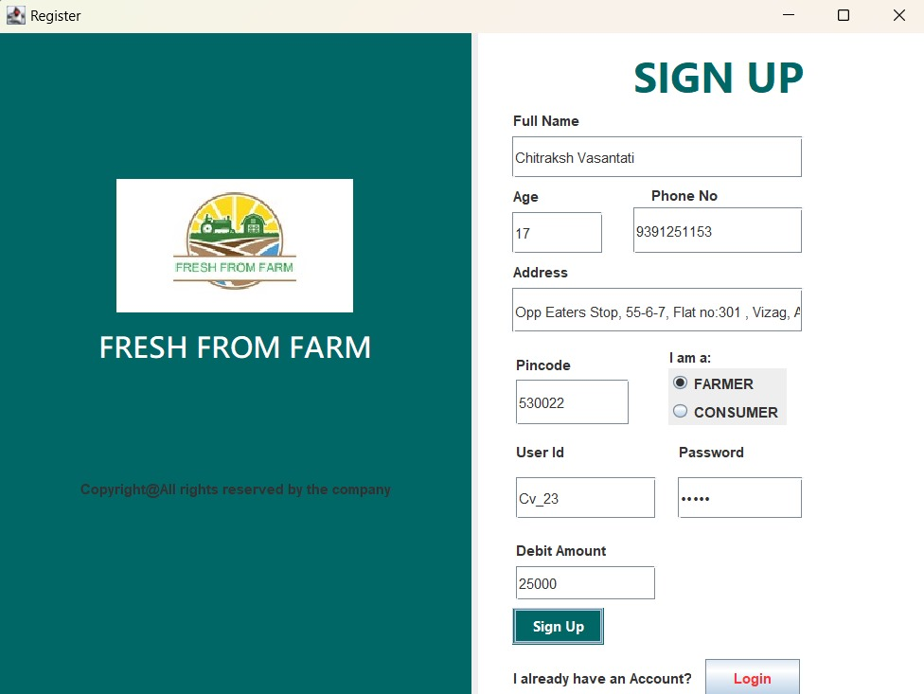
Sign Up Panel
This panel can be accessed from Login Panel.
When the user fills all the fields, the details are updated in the database and the user is sent back to the login page where they can enter their details.
The panel also checks for any mistakes in the inputs and returns dialog boxes providing instructions.
Alternatively, one can return to the login page by pressing the login button.

Slide 8
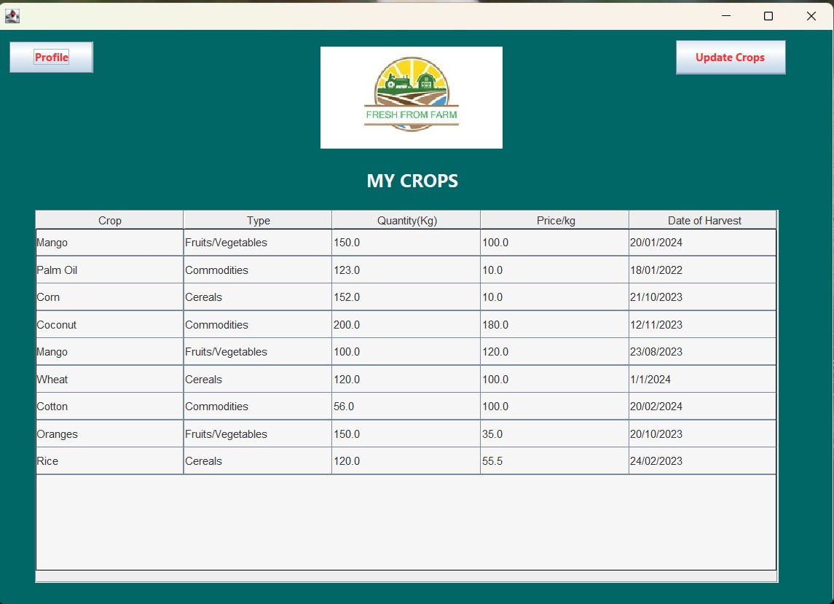
Farmer Homepage
Here, the farmer can look at their crops.
The table displays the latest ten crops
Update Crops button opens the update crops panel.
Profile button opens the profile panel.

Slide 9
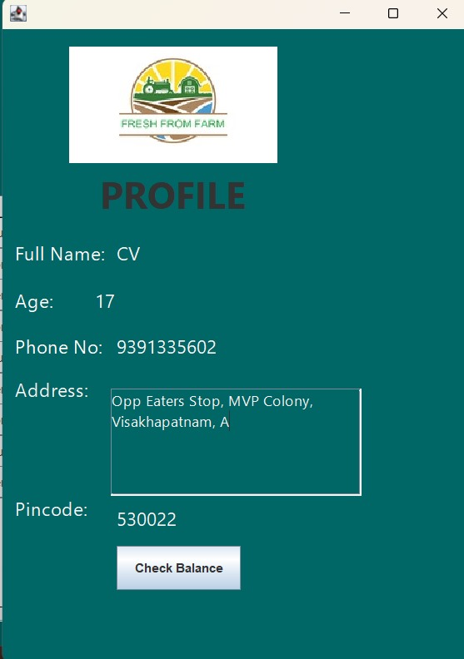
Profile Panel
This panel displays the details of the user such as their name, age, phone number, address, pincode.
When the check balance button is pressed, a dialog box opens which shows the current bank balance of the user.

Slide 10
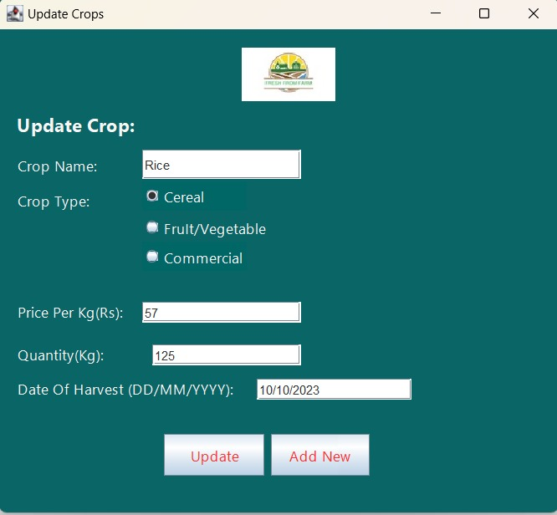
Update Crops Panel
Farmer can access this panel from homepage and use it to add crops.
Multiple details such as the type of crop, name of crop, price, quantity, date of harvest should be given which gives more detail to the consumer purchasing the goods.
When the user presses add new button, the system stores the entered crops, clears the field and prepares itself for a new entry, thus eliminating the need to repeatedly go back to homepage when adding multiple crops.
Update button stores the data in the database

Slide 11
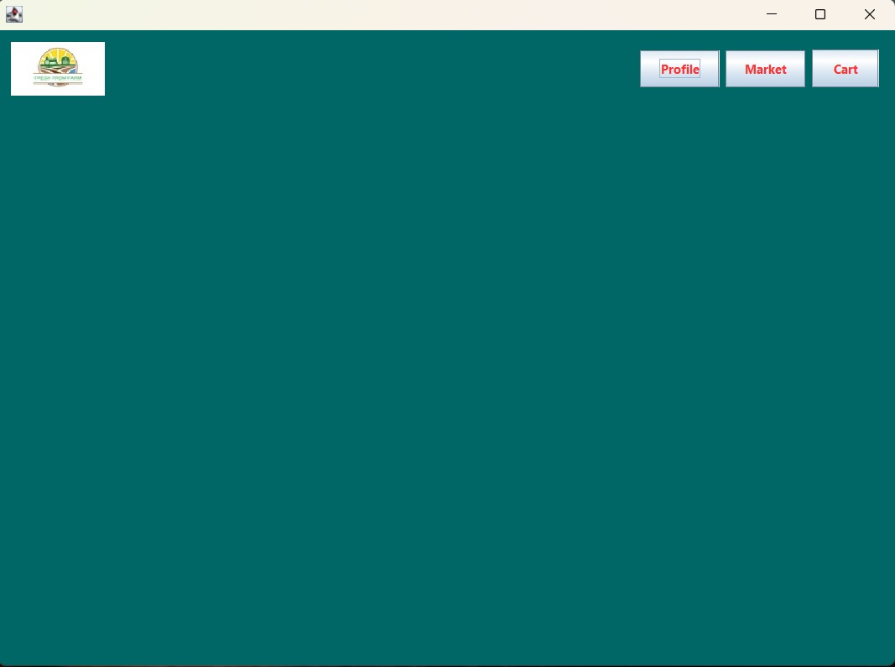
Panels Under Development
Some panels are not yet fully developed.
A list of these are:
Consumer Homepage
Cart

Slide 12
Thank you

